Slide 1

Bayer Derm Call Plan S1 & S2 2014 Internal Sharing
Presentation by: Bing Ren
Notes:
Title – Bayer Derm Call Plan S1 & S2 2014 – Internal Sharing

Slide 2
Agenda
Introduction
Project Background – preparation for the study
Methodology
Core Steps
Deliverables

Slide 3
Introduction
What is call planning ?
Call planning is a step to implement optimal sales force deployment and gives the sales reps detailed directions
A call plan guides field representatives on:
- who are the physicians to be detailed
- where these physicians can be located
- which products are to be promoted (and in which order)
- how often each physician should be visited
- What message should be given to each doctor

Slide 4
Introduction
Veeva System
Client system where field representatives could easily search
for targets’ demographics and prescribing behaviors, also
where the call plan can be tracked by the sales team.
Bayer Derm Call Plan History
Recently updated on March 2012 before the new refresh for
2014 Q1 & Q2

Slide 5
Agenda
Introduction
Project Background – preparation for the study
Methodology
Core Steps
Deliverables

Slide 6
Project Background
Market Landscape – understand the whole market 1

Slide 7
Project Background
Market Landscape – understand the whole market 2

Slide 8
Project Background
Market Landscape – understand the whole market 3

Slide 9


Project Background
Market Landscape – understand the whole market 4
Rosacea Market
MPS Market
Finacea
Other Products
Desonate
Other Products
2 POIs involved in this call plan
-Finacea, Dermatology, mild to moderate rosacea
-Desonate, Dermatology, mild to moderate atopic dermatitis

Slide 10
Project Background
Key Inputs – Data Sources
MAT TRx file - extracted based on Mkt Definition, reveals prescribing
history of the Mkt, also used to generate physician universe
Client call file - used to track how the historical call plan was performed
by the field as well as which doctors were previously called-on
Historical call plan – call plan of last semester
Sample and redemption – used to track sample distribution and # of
redemptions
Zip to Territory file – important bridge file from zip to territory
Prescriber Universe file, IMS Best Address file, HCOS file – used when
attaching physicians’ demographics to the universe

Slide 11
Project Background
Key Inputs – field capacity
understand the workload of sales team
Capacity Related Variables | Year 1
annual field days | 200
calls per day | 8
annual calls per rep | 1600
# of current reps | 70
total rep capacity | 112,000
vacancy rate | 6%
adjusted total rep capacity | 105,280
cost per Full Time rep (annual) | $ 198,387
cost per call | $ 131.91

Slide 12
Project Background
Key Inputs – TRx forecast and average price per Rx
- These variables can be utilized to forecast product-level total revenue for the next year.

Slide 13
Agenda
Introduction
Project Background – preparation for the study
Methodology
Core Steps
Deliverables

Slide 14
Methodology
Methodology for this call plan is quite straight forward
1. Identify key targets in the market
By prescription volume, yearly growth etc.
2. Attach physician demographics and make a universe
Especially their address lines, Zip codes and States
3. Have all targets segmented
By decile or quintile, other characters could be fed into segmentation

Slide 15
Methodology
Methodology for this call plan is quite straight forward
4. Apply field changes to the physician universe
Adds, deletes, moves and no-sees
5. Assign call frequency to physicians based on their segments
Utilize results from response analysis or defined frequency
6. Assign targets to each territory with defined workload
Balance workload for each territory and make additional adjustments to physicians’ frequencies if needed

Slide 16
Agenda
Introduction
Project Background – preparation for the study
Methodology
Core Steps
Deliverables

Slide 17
Core Steps
Identify potential targets in the market
– normally by physician’s prescribing history
brand quintiles / deciles
market quintiles / deciles
brand share / market share / NBRx share
% of pay types – Cash, 3rd Party, Medicare, Medicaid
brand yearly growth
called-on history
# of samples received

Slide 18
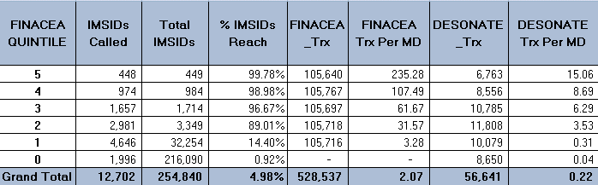
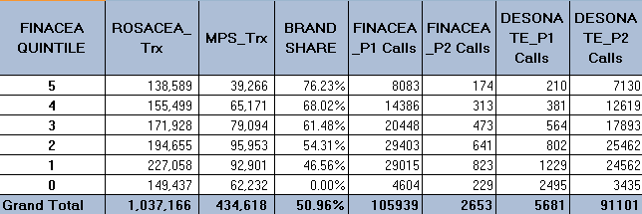
Core Steps
Gain a view of the market – summaries and crosstabs

Slide 19
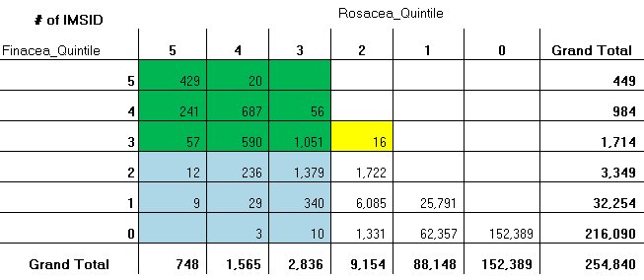
Core Steps
Gain a view of the market – summaries and crosstabs

Slide 20
Core Steps
Create physician universe file
1. include numeric metrics just been calculated
deciles, shares etc.
2. append physician demographics
address lines1, city, state, Zip
specialty, specialty group, territory ID*
1 There are two primary address sources in the study – refer to next slice

Slide 21
Core Steps
Create physician universe file – address sources
Veeva Address
IMS Best Address
Client address in Veeva
system
Constantly updated – due to field feedbacks
Contains only historical targets
IMS Address master file
Monthly updated
Contains all physicians
in the market that could
be tracked by IMS
Link to “IMS Best Address” folder:
\\Plyvnas01\statservices2\CustomStudies\Sales & Account Management\@Library\Best Address
Notes:
- Show veeva address file and IMS Best address file

Slide 22
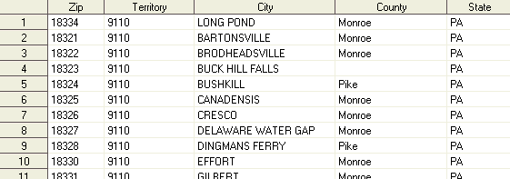
Core Steps
Create physician universe file – client territory alignment
* Zip to Territory File
client bridge file between Zip codes and Territories
(updated for each call plan refresh, contains most recent
client’s geographic adjustments of sales force nationally)

Slide 23
Core Steps
Apply field changes to universe file
Add doctors:
New targets in the market or high-value target moved into a rep’s territory
Action: must be included in the final call plan
Delete doctors:
Deceased, non-target
, retired, conflict,
other reasons, low tier target
Action: should be deleted from that
territory
Move doctors:
Targets moved out or can not be located in certain territories
Action: should be deleted from that
territory
No-see doctors:
Any target requests no rep visit to the office or clinic
*Action: should be deleted from that
territory
Other Revisions:
Incorrect information of any physician’s demographics, incorrect IMSID or other
ID that helps to identify the physician,
forced alignment (territory or frequency) and any other reason specified in the file.

Slide 24
Core Steps
Apply field changes to universe file – check conflicts
Field changes file is at (Rep)/IMSID/Territory level. Any action in this step should be taken on IMSID/Territory combination (if not requested in a different way). Please refer to the example below:
Two requests received:
Move list: IMSID 1234567/ Territory 9310
Add list: IMSID 1234567/ Territory 9110
Territory 9310
IMSID
1234567
Territory 9110

Slide 25
Core Steps
Apply field changes to universe file – check conflicts
Field changes file is at (Rep)/IMSID/Territory level. Any action in this step should be taken on IMSID/Territory combination (if not requested in a different way). Please refer to the example below:
Two requests received:
Delete list: IMSID 1234567/ Territory 9110
Add list: IMSID 1234567/ Territory 9110
IMSID
1234567
Territory 9110
Territory 9310
Conflict

Slide 26
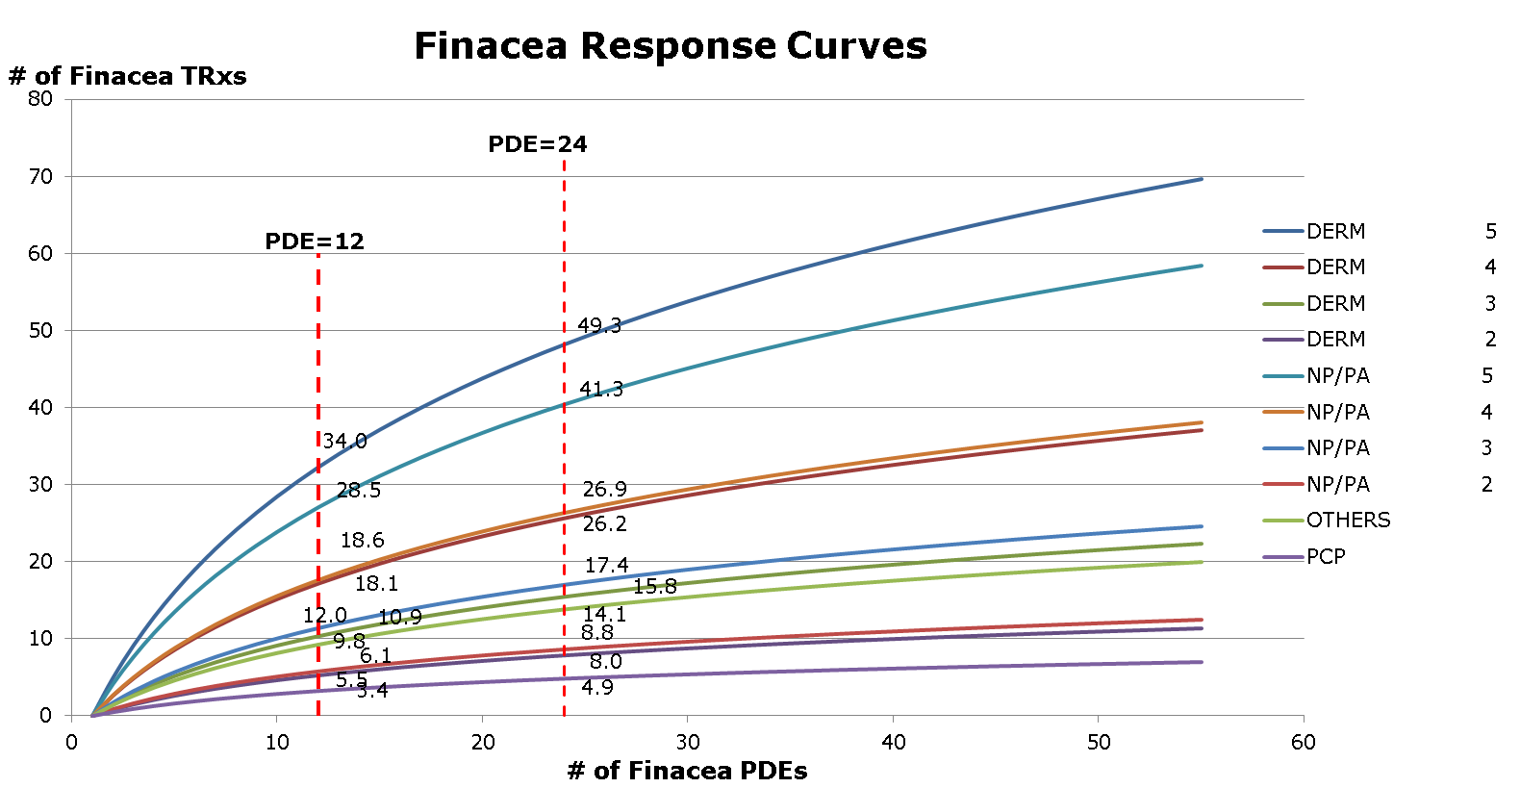
Core Steps
Create segment level response curves for each brand (Optional) - get optimal PDE for each group

Slide 27
Core Steps
Coordinate with consulting team (and client) to settle final frequency and product assignment for each segment
Group | Frequency
Quintile 5 | 24
Quintile 4 | 18
Quintile 3 | 12
Quintile 2 | 12
Quintile 1 | 12
Quintile 0 | 0
Q0 Add | 12
- Do not assign Finacea to Peds

Slide 28
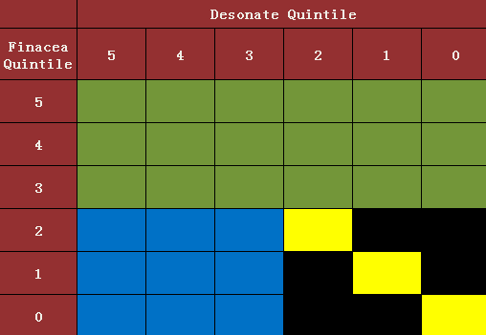
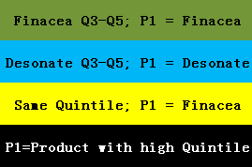
Core Steps
Coordinate with consulting team (and client) to settle final frequency and product assignment for each segment
For P2, if Mkt-Quintile of the other POI >0, then assign that product; otherwise, assign ‘None’.

Slide 29
Core Steps
Generate final call plan - assign call frequency and P1/P2 product to the universe
Add doctors
Add doctors must be included
Quintile 5
doctors
Take as more high valuable targets (high quintiles) as possible
for each territory
Quintile 4
doctors
Quintile 3
doctors
Cut the boundary according to defined workload (1600) for each territory

Slide 30
Core Steps
Generate final call plan - assign call frequency and P1/P2 product to the universe
How to calculate PDE ?

Slide 31
Agenda
Introduction
Project Background – preparation for the study
Methodology
Core Steps
Deliverables

Slide 32
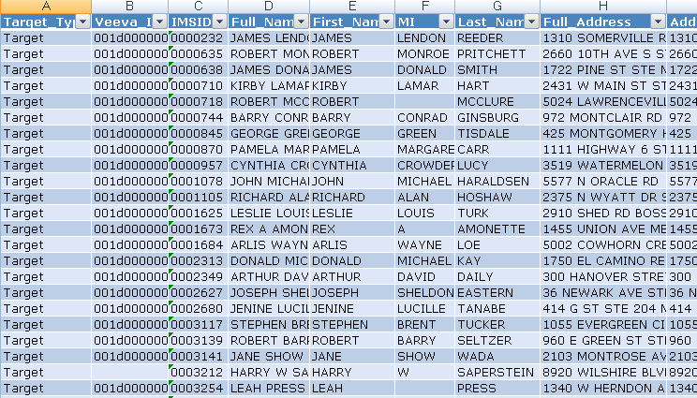
Deliverables
Deliverable 1 – Call plan in excel version

Slide 33
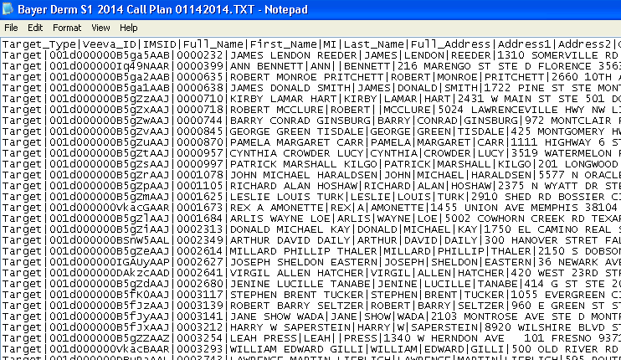
Deliverables
Deliverable 2 – Call plan in Veeva format

Slide 34
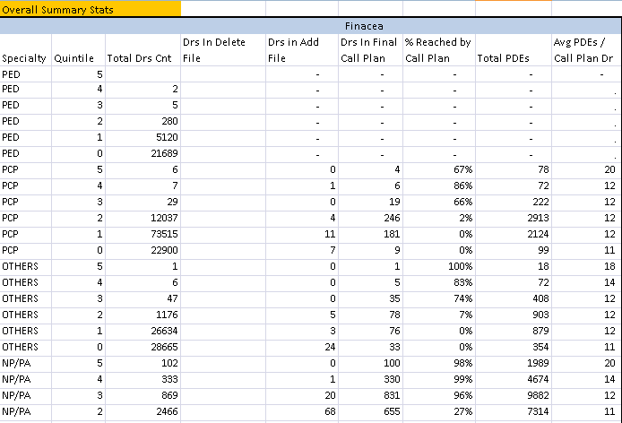
Deliverables
Deliverable 3 – Call plan summaries

